Slide 1
PLACEMENT ELIGIBILITY STREAMLIT APPLICATION
DOMAIN – DATA SCIENCE
Presented By
KEERTHANA A

Slide 2
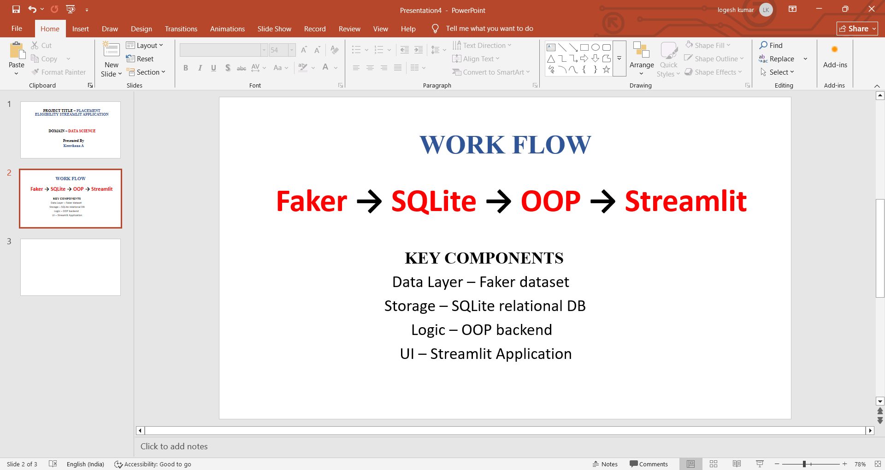

Slide 3
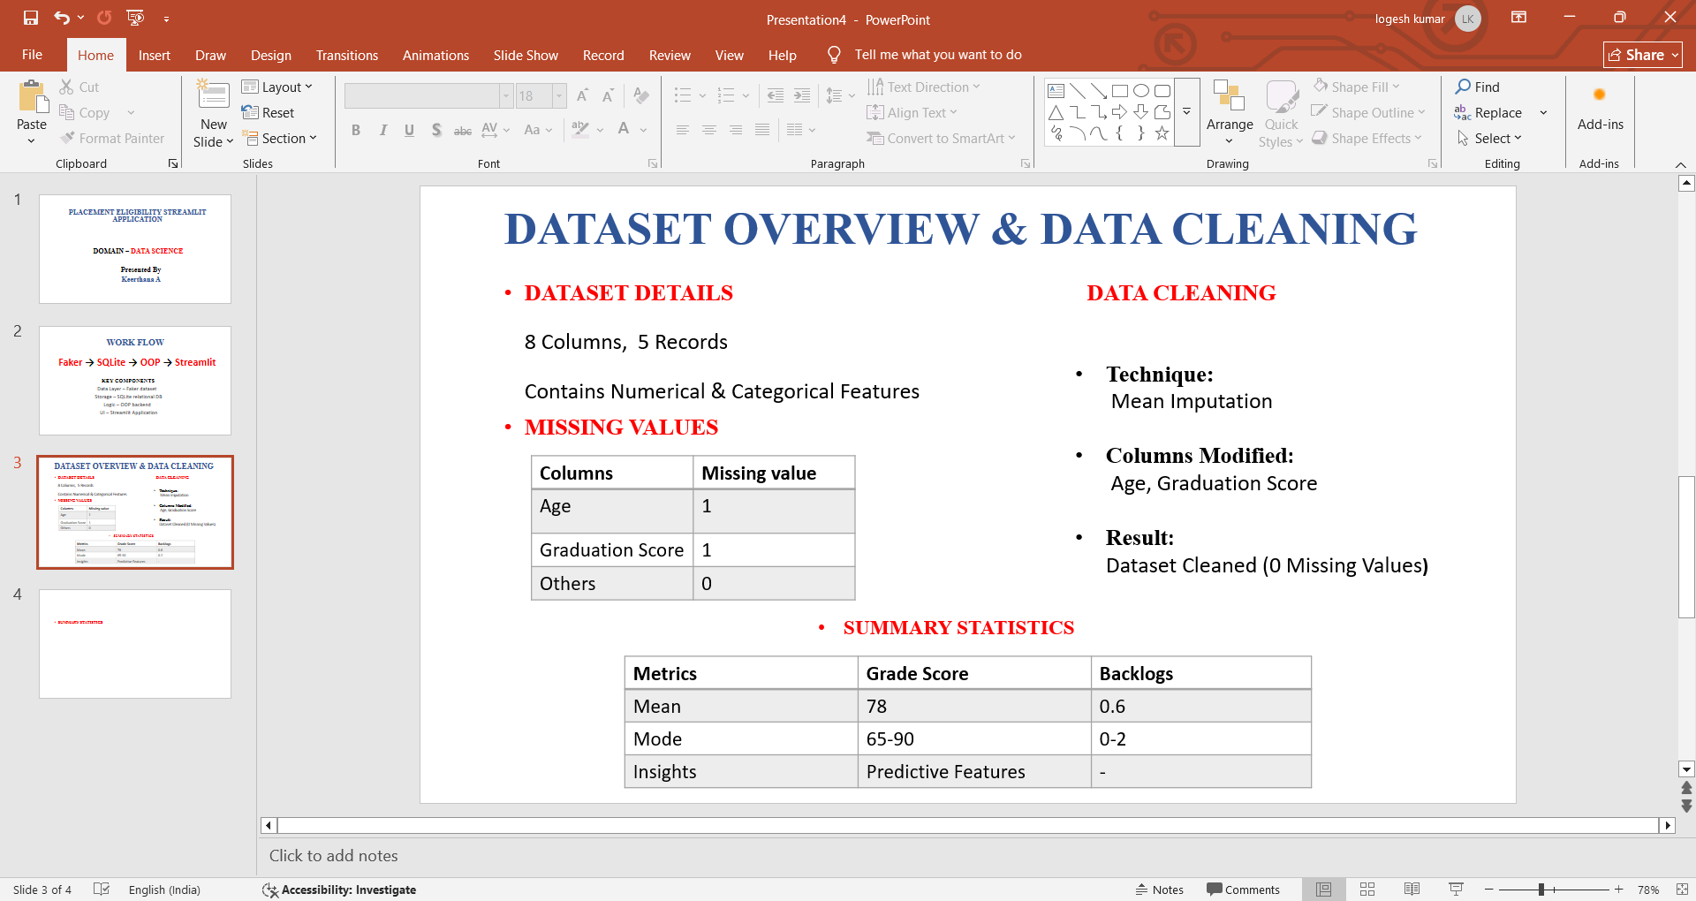
Metric | Graduation Score | Backlogs
Mean | 78 | 0.6
Range | 65 – 90 | 0 – 2
Insight | Useful Predictive Features | -

Slide 4
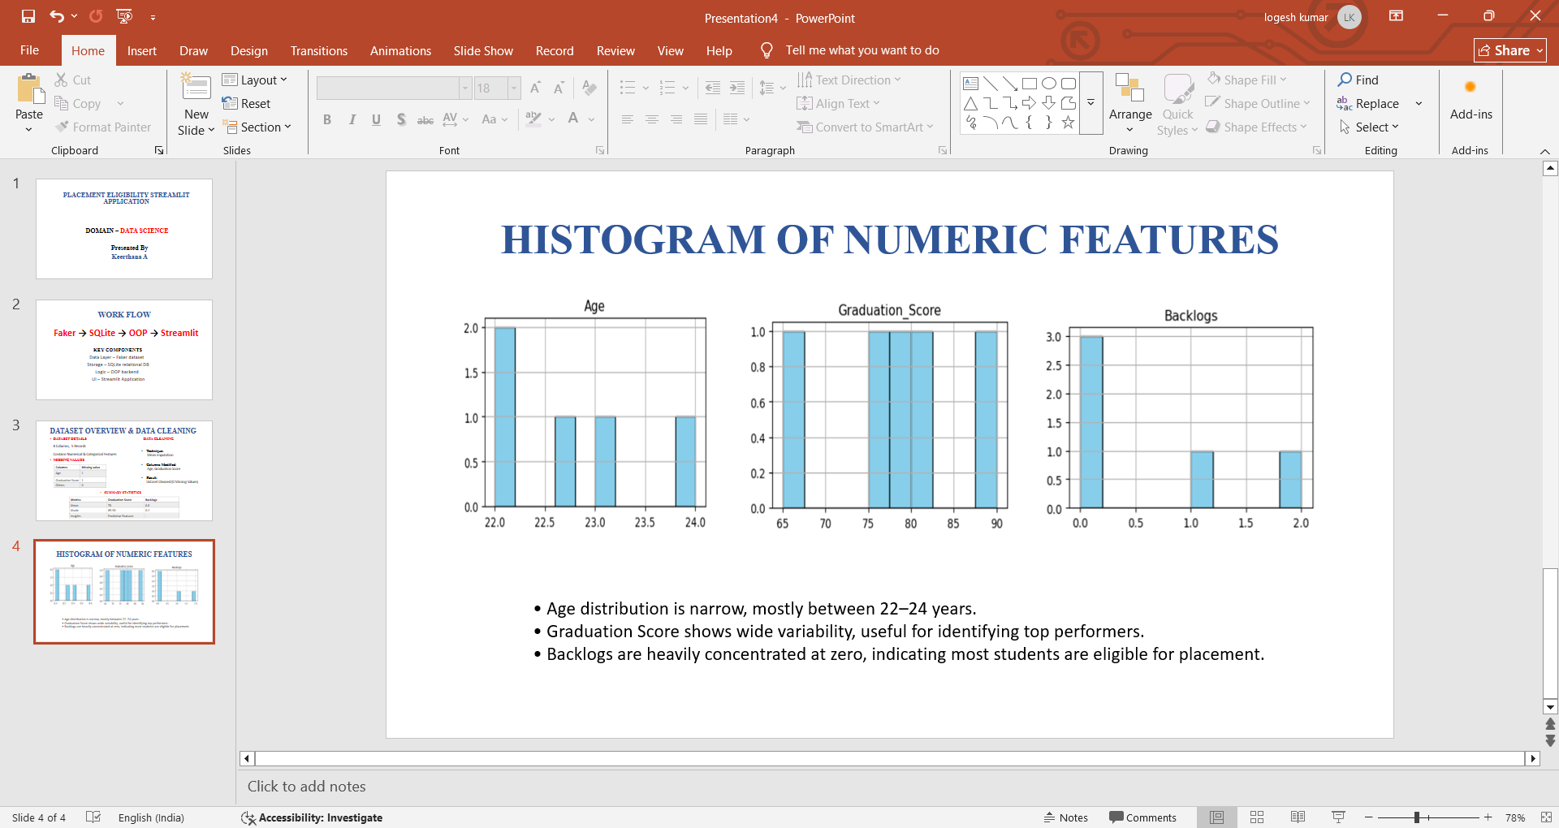
UNIVARIATE ANALYSIS - HISTOGRAMS OF NUMERIC FEATURES

Slide 5
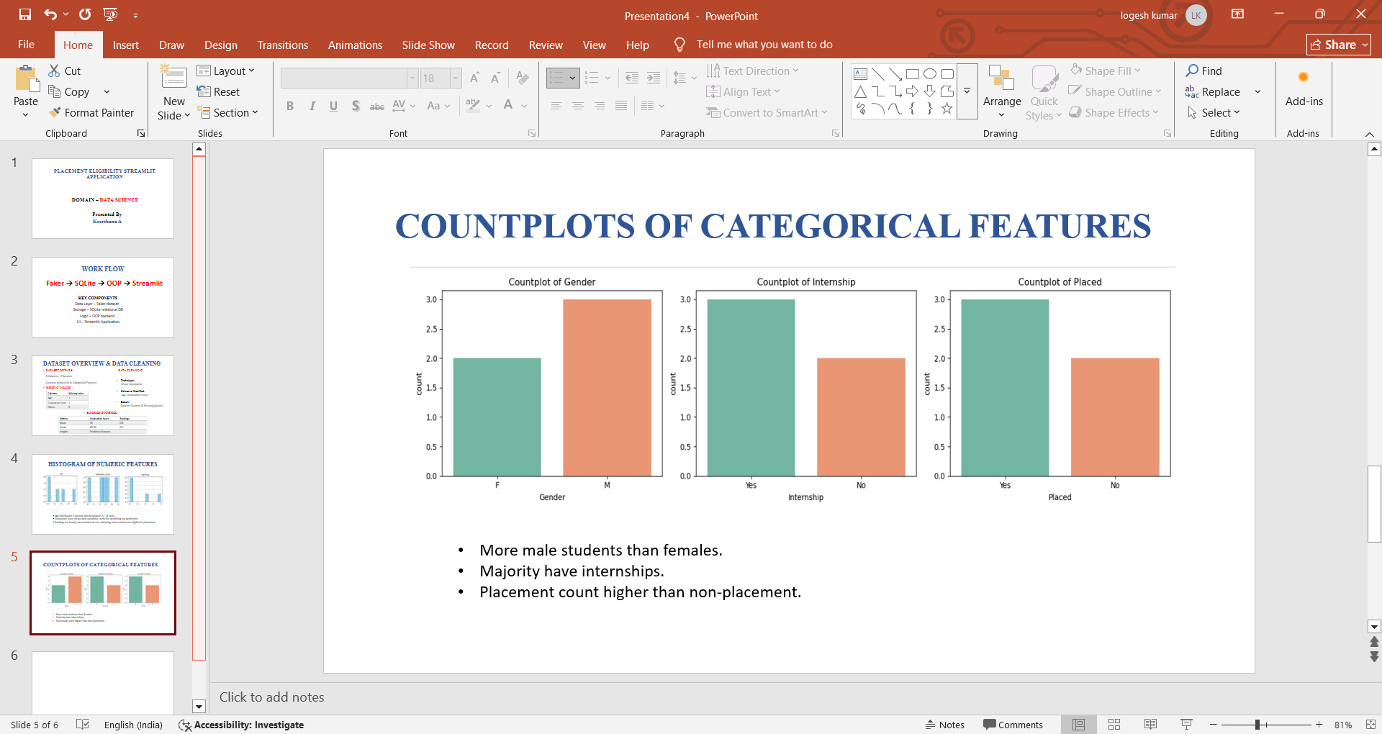
UNIVARIATE ANALYSIS – COUNTPLOTS OF CATEGORICAL FEATURES

Slide 6
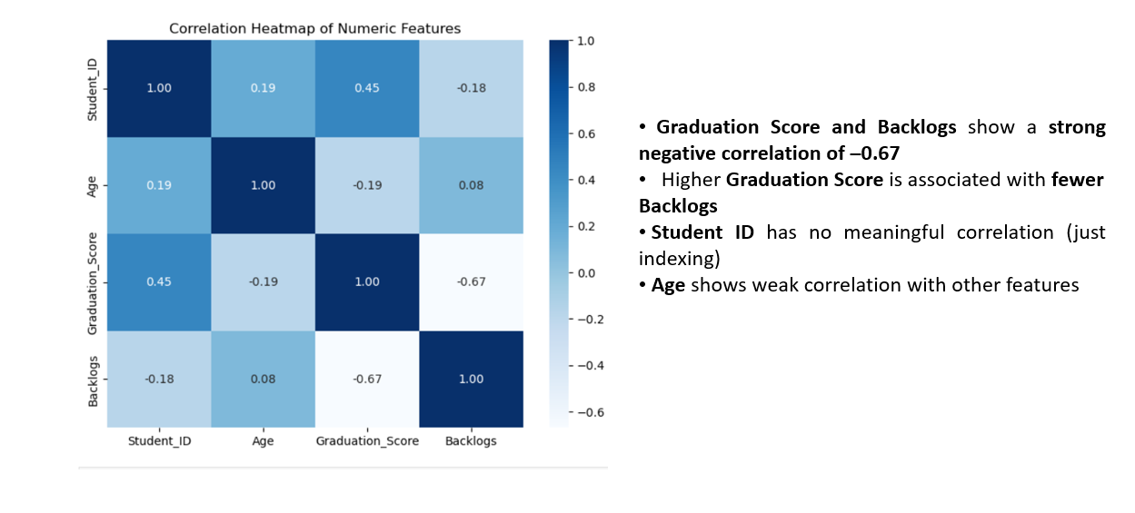
BIVARIATE ANALYSIS – CORELATION HEATMAP OF NUMERIC FEATURES

Slide 7
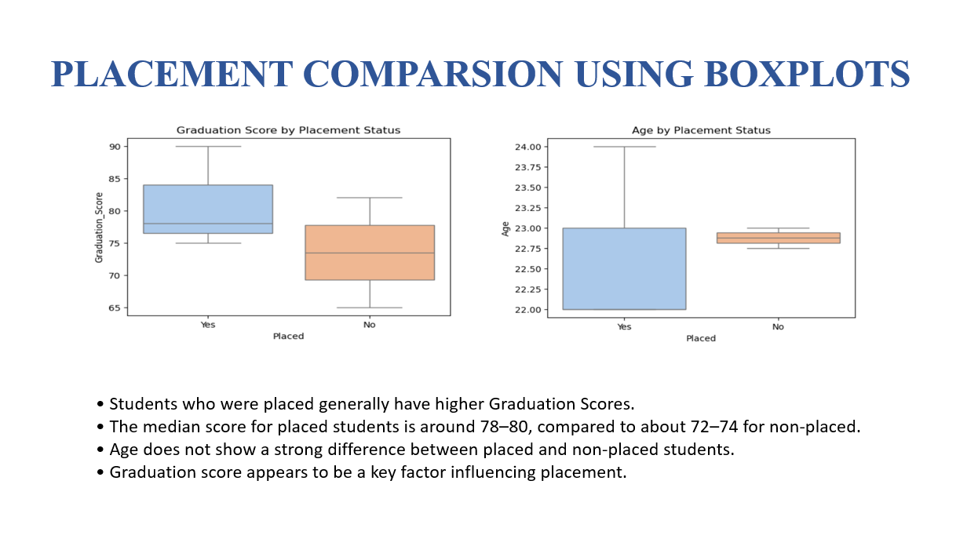

Slide 8
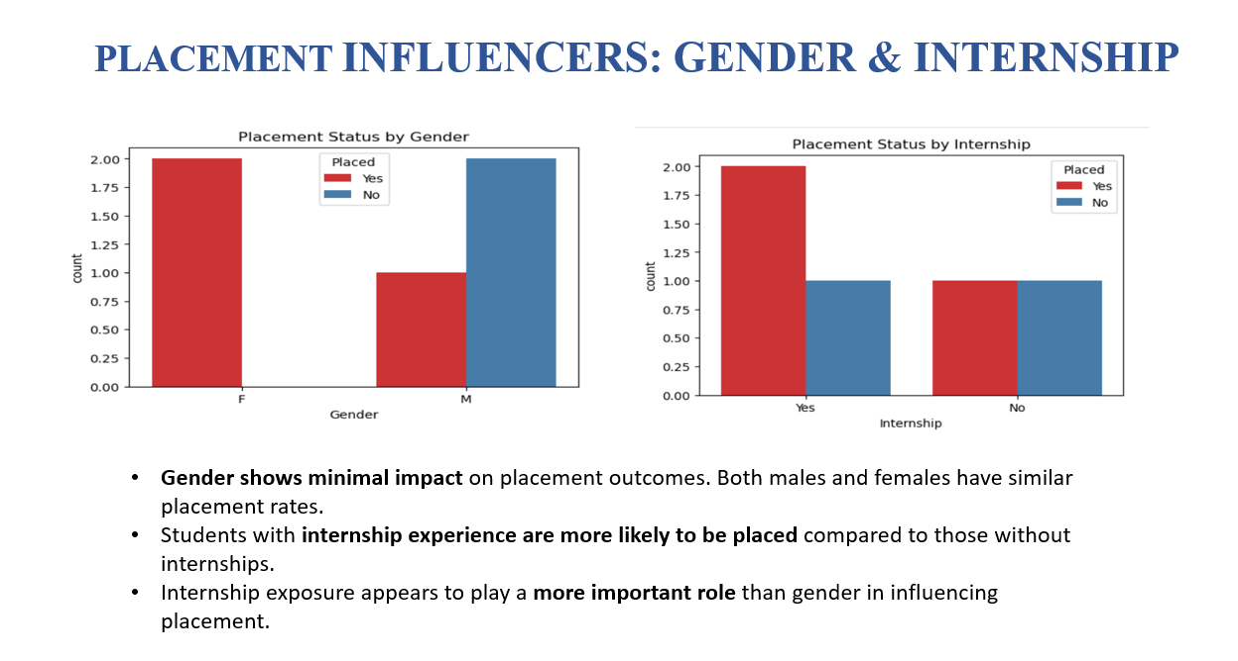

Slide 9
ANALYTICAL DEPTH THROUGH SQL VALIDATION
Strategic SQL Queries Implemented:
Benchmarking: Computed batch-wise averages for programming and soft-skills performance.
Action List Automation: Identified “ready but not placed” high-potential students for targeted intervention.
Top Performer Ranking: Ranked students based on combined academic, programming, and soft-skills indicators.
Placement Intelligence: Analyzed placement distribution, internship impact, and average package trends.
Purpose: Ensures insights are validated, data-driven, and operationally actionab

Slide 10
OBJECT-ORIENTED PROGRAMMING (OOP) IMPLEMENTATION
Class → Database Manager → Data Loader → Filter Manager
OOP Architecture Implemented
Database Manager (Encapsulation) Handles database connections through connect() and close(), ensuring safe and controlled resource usage.
Data Loader (Separation of Concerns) Executes multi-table SQL LEFT JOIN, computes derived fields like avg_softskills, and centralizes all data preparation.
Filter Manager (Abstraction) Contains all filtering logic using Pandas conditions, allowing the main workflow to simply call filter students().
Result
OOP structure keeps the code modular, reusable, and easy to maintain.

Slide 11
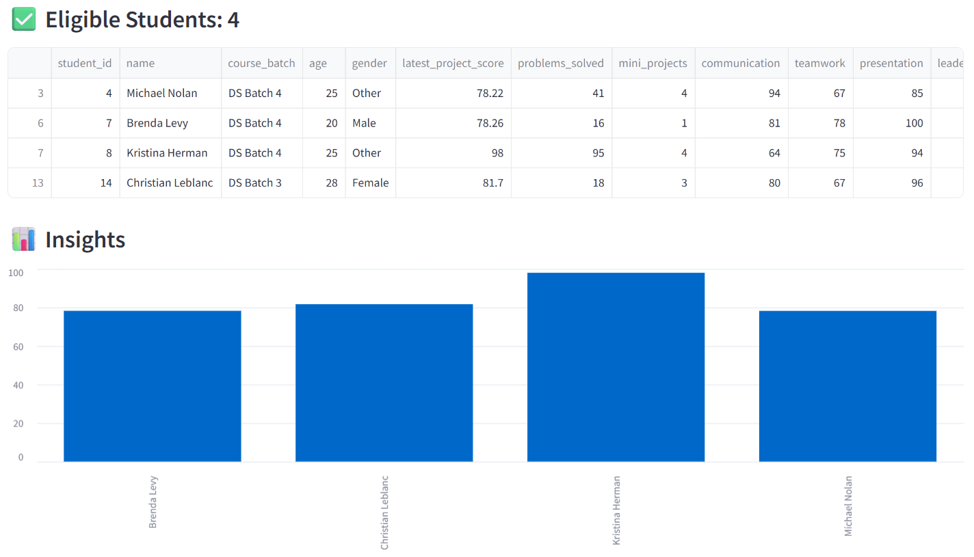
STREAMLIT APPLICATION - UI VALIDATION
Dashboard Insights
Dynamic filters: Batch, Minimum Programming Score, Minimum Average Soft Skills
Real-time output: Shows number of eligible students (e.g. “Eligible Students: 4”)
Screenshot shows real-time filtering and eligibility output when criteria are adjusted.

Slide 12
CONCLUSION
End-to-end placement eligibility system implemented.
Integrated SQL, OOP, and Streamlit UI for real-time filtering.
Ensures accuracy, transparency, and data-driven decisions.
Can be extended with:
Resume scoring
predictions
ML-Based interview readiness metrics

